Slide 1

iVision
Customer Service Data Analysis

Slide 2
iVision
Objective:
Nile is an E-commerce company collaborated with iVision, intending to improve their customer service, and wants to get data-driven insights and actionable recommendations based on sentiment analysis and root cause identification on their customer service request data.
To help Nile make better business decisions and improve their services, iVision is engaged to provide Nile access to the analytics dashboard and report i.e., Real time monitoring dashboard.
Resource:
Nile has shared its customer service data with iVision.

Slide 3
iVision
CRISP – DM
It stands for CRoss Industry Standard Process for Data Mining, is an industry-proven way to guide our data mining efforts.
- As a methodology, it includes descriptions of the typical phases of a project, the tasks involved with each phase, and an explanation of the relationships between these tasks.
- As a process model, CRISP-DM provides an overview of the data mining life cycle.
- This life cycle model consists of six phases with arrows indicating the most important and frequent dependencies between phases. The sequence of the phase is not strict.

Slide 4
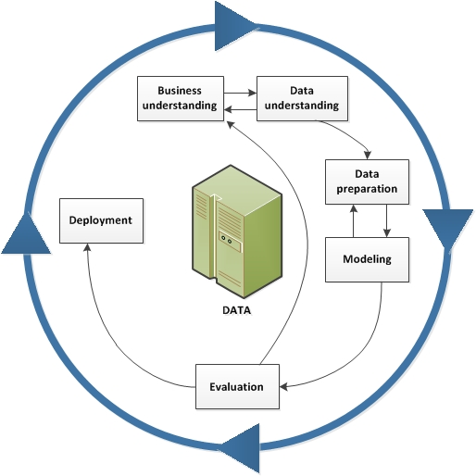
iVision
Business Understanding
Data Understanding
Data Preparation
Modeling
Evaluation
Deployment

Slide 5
iVision
Business Understanding:
Nile, as an e-commerce company it caters a large number of consumer who makes various transaction deemed to have various queries which is needed to be dealt by company’s customer care department. Company has multiple channel through which customers can raise their inquiry such as Call center, Email, Chatbot and Web.
Thus, a study is commissioned with the following objective:
Customer Sentiment Analysis
Root Cause Analysis
Service Response Time Analysis
Customer Segmentation
Trends and Pattern Identification
Process Improvement

Slide 6
iVision
Data Understanding:
Data understanding involves accessing the data to determine the quality of the data and in avoiding unexpected problems during the next phase, data preparation for further analysis.
Data Description:
id: Unique Customer ID
customer_name: Name of the customer
sentiment: Sentiment of the customer (Neutral, Positive, Very Positive, Negative, Very Negative)
csat_score: Customer Satisfaction Score (Scale of 1 to 10, 1 being lowest and 10 being Highest)

Slide 7
iVision
call_timestamp: Date on which the call was made by the customer.
reason: Reason why the customer called (Billing Question, Service Outage & Payments)
city: City to which the customer belongs.
state: State to which the customer belongs.
channel: Mode of communication that customer used (Call-center, Chatbot, Email, Web)
response_time: How fast the customer request was serviced (SLA level: Above SLA, Below SLA, Within SLA)
call duration in minutes: Duration of the call
call_center: Location of the call center where service request was handled.

Slide 8
iVision
Data Preparation:
Data preparation is one of the most important and often time-consuming aspects of data mining. Depending on the organization and its goals, data preparation involves the following tasks:
Selecting Data
Cleaning Data
Constructing New Data
Integrating Data
Formatting Data

Slide 9
iVision
Data Preparation - Steps Undertaken:
On the starter, I have preserved the raw data and named the sheet as “Call_Center_data”.
Copied the original data to another sheet named, “Working_Data” for the required data preparation.
Table metrics: Column – 12, Rows – 32,942 (including header)
Bound the whole data as a single table named, “Table1”.
csat_score: It has almost over 62% of data is missing which makes unreliable to make any analysis and there is no other relative/dependent data to populate these data. I will skip this column for analysis.
Created a column named “Call_day” to extract the day of the month from the call_timestamp. Used Day function.
Created a column named “Sentiment_Criteria”. Confined the value of sentiment into 3 category as Neutral, Positive (Positive + Very Positive) & Negative (Negative + Very Negative). Used combination of IFS and OR function.
Created a column named, “TAT” to set a range to call duration and compute the performance for turn around time. This will label as In Range (Up to 25 min), High (25> AND <= 35) & Very High (>35) to the calls which is talking longer minutes to wrap up. The average call time is set as In Range value.

Slide 10
iVision
Data Preparation - Steps Undertaken:
call_timestamp: The data is recorder for the month of October 2020 but the date format is all mixed up. Filtered the column to identify the data with irregular formatting. Used “Text to Column” function in Data menu to segregate the day, month and year value in 3 new column created in the right. Used “Date” function to get the correct date format using these new values.
Created a new sheet, “Data_Table” and inserted various Pivot Table sourcing data from Table1 to discover various information such as,
Parameter | Value
# of Calls | 32941
Total Call Duration | 824222
Average Call time | 25.02
Sentiment | # of Queries
Positive | 7098
Neutral | 8754
Negative | 17089
Grand Total | 32941
Reason | # of Queries
Service Outage | 4730
Payments | 4749
Billing Question | 23462
Grand Total | 32941
Channel | # of Queries
Web | 6576
Email | 7470
Chatbot | 8256
Call-Center | 10639
Grand Total | 32941
TAT | # of Inquiry
Very High | 8027
High | 8137
In Range | 16777
Grand Total | 32941
Response Time | # of Inquiry
Above SLA | 4168
Below SLA | 8148
Within SLA | 20625
Grand Total | 32941

Slide 11
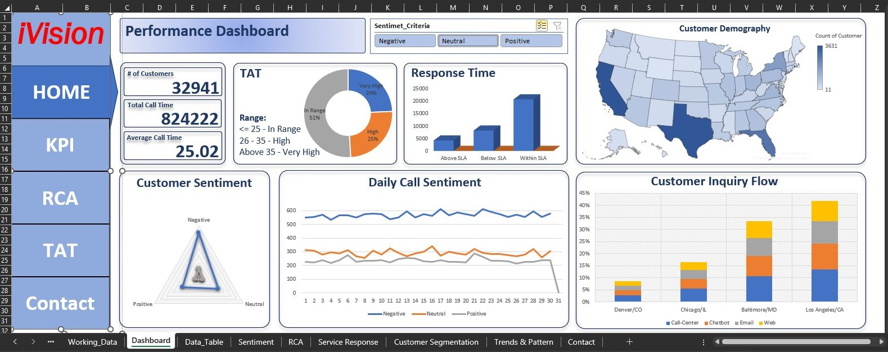
iVision
Dashboard:
The Excel Dashboard is used to display overviews of large data tracks.
Excel Dashboards use dashboard elements like tables, charts, and gauges to show the overviews.
The dashboards ease the decision-making process by showing the vital parts of the data in the same window.

Slide 12
iVision
1. Customer Sentiment level
a) Overall customer sentiment.
b) Customer sentiment with respect to reason.
Sentiment | # of Customer | % of Customer
Negative | 17089 | 52%
Neutral | 8754 | 27%
Positive | 7098 | 22%
Grand Total | 32941 | 100%
Sentiment | Billing Question | Payments | Service Outage | Grand Total
Negative | 12168 | 2490 | 2431 | 17089
Neutral | 6232 | 1238 | 1284 | 8754
Positive | 5062 | 1021 | 1015 | 7098
Grand Total | 23462 | 4749 | 4730 | 32941

Slide 13
iVision
2. Root cause Analysis

Slide 14
iVision
3. Service Response Time Analysis
TAT Range: <= 25 is In Range, Between 25 to 36 is High & above 35 is Very High
a. Call Center wise call flow report:
Parameter | Value
# of Calls | 32941
Total Call Duration | 824222
Average Call time | 25.02
TAT | # of Inquiry
Very High | 24%
High | 25%
In Range | 51%
Grand Total | 32941
Response Time | # of Inquiry | % of Inquiry
Above SLA | 4168 | 13%
Below SLA | 8148 | 25%
Within SLA | 20625 | 63%
Grand Total | 32941 | 100%
Call Center | # of Query | Total Call time | Average Call time
Baltimore/MD | 11012 | 274881 | 25
Chicago/IL | 5419 | 135814 | 25
Denver/CO | 2776 | 69446 | 25
Los Angeles/CA | 13734 | 344081 | 25
Grand Total | 32941 | 824222 | 25

Slide 15
iVision
b. Call Center wise TAT report:
c. Call Center wise Response Time report:
Call Center | In Range | High | Very High | Grand Total
Baltimore/MD | 51% | 25% | 24% | 100%
Chicago/IL | 50% | 25% | 25% | 100%
Denver/CO | 51% | 25% | 24% | 100%
Los Angeles/CA | 51% | 25% | 24% | 100%
Grand Total | 51% | 25% | 24% | 100%
Call Center | Within SLA | Below SLA | Above SLA | Grand Total
Baltimore/MD | 62% | 25% | 13% | 100%
Chicago/IL | 62% | 25% | 13% | 100%
Denver/CO | 63% | 25% | 12% | 100%
Los Angeles/CA | 63% | 24% | 13% | 100%
Grand Total | 63% | 25% | 13% | 100%

Slide 16
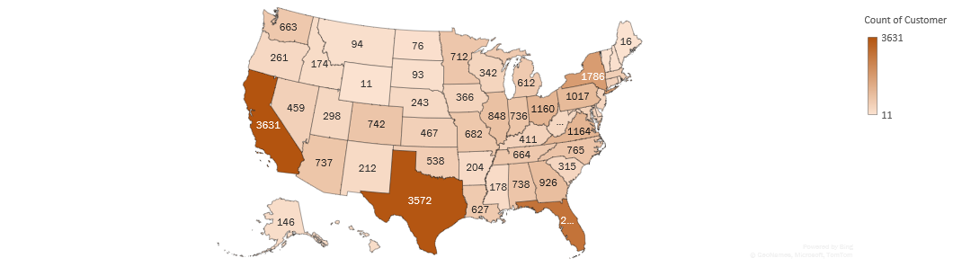
iVision
4. Customer Segmentation
a) Customer Demography

Slide 17
iVision
b) Customer Inquiry demography

Slide 18
iVision
c) Customer Sentiment demography

Slide 19
iVision
5. Trends and Patterns Identification
a) Daily Customer Sentiment

Slide 20
iVision
5. Trends and Patterns Identification
a) Customer Inquiry Flow
Call Center | Call-Center | Chatbot | Email | Web | Grand Total
Denver/CO | 3% | 2% | 2% | 2% | 8%
Chicago/IL | 5% | 4% | 4% | 3% | 16%
Baltimore/MD | 11% | 8% | 7% | 7% | 33%
Los Angeles/CA | 14% | 10% | 10% | 8% | 42%
Grand Total | 32% | 25% | 23% | 20% | 100%

Slide 21
iVision
5. Trends and Patterns Identification
b) Resource Allocation
Channel | Billing Question | Payments | Service Outage | Grand Total
Call-Center | 55% | 45% | 0% | 100%
Chatbot | 71% | 0% | 29% | 100%
Email | 79% | 0% | 21% | 100%
Web | 88% | 0% | 12% | 100%
Grand Total | 71% | 14% | 14% | 100%

Slide 22
iVision
Conclusion:
RCA demonstrates that major negative sentiments is contributed by Los Angles & Baltimore Call center.
Trend & Pattern demonstrate that call flow ratio in Denver, Chicago, Baltimore & Los Angeles are as 1:2:4:5 respectively which can help us determine the human resource to allocate the manpower accordingly. Also, we can determine the number of employee to be assigned to which channel and in which category (Reason) in each call center. Refer to Resource allocation chart.
From Service Response Time Analysis, it is found that average call time is around 25 minutes and we can determine the call center needs to reduce the call duration depending on the reason to increase the efficiency and turn around time. Also, we can analyse the response time to focus on Calls that are above SLA.

Slide 23
iVision
6. Contact Us
Prepared & Presented by
Warun Kumar
ABADS B 11
Phone: 9999730408
Email: warunsrk@gmail.com

Slide 24
iVision
Time for Q & A

Slide 25
iVision
Thank you ☺

